Slide 1
claude --resume 1d34a6cd-6c9d-437a-905d-eb6a4b71f30b
claude --resume f0854f86-f4b3-43a7-acae-6f45faa9eb2d
claude --resume 8e3ec54f-950f-4de9-8887-44e0e071df77
claude --resume 03bf0cfb-c9b9-4214-88da-5c765cf1c096
claude --resume 9fd5c89f-df33-4f0f-99d1-0dec9b55c780
claude --resume d22121de-0076-4bc5-8857-4004fbe4e2b0
claude --resume ba44017c-e939-4695-9db3-e30cdbd5fd57
claude --resume 87492646-4299-4efd-93c4-fa898c462dfe
claude --resume d535abff-6171-4ccd-84a3-c909639bc8a9
claude --resume f559d6c3-ab79-41ae-9002-7b1c06a463a3

Slide 2
Adding friction
SNR from ILC
Jerk limited

Slide 3
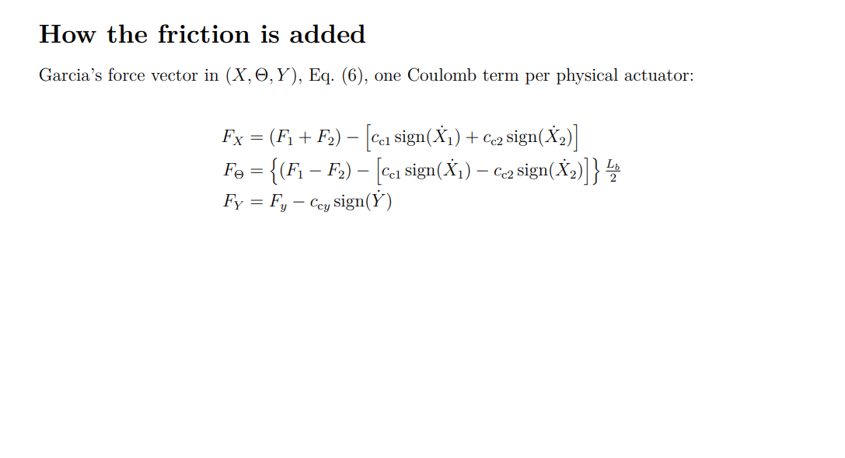
Notes:
F_Xs = (F1+F2) − [cc1 sign(Ẋ1) + cc2 sign(Ẋ2)]
F_Θs = {(F1−F2) − [cc1 sign(Ẋ1) − cc2 sign(Ẋ2)]}·Lb/2

Slide 4
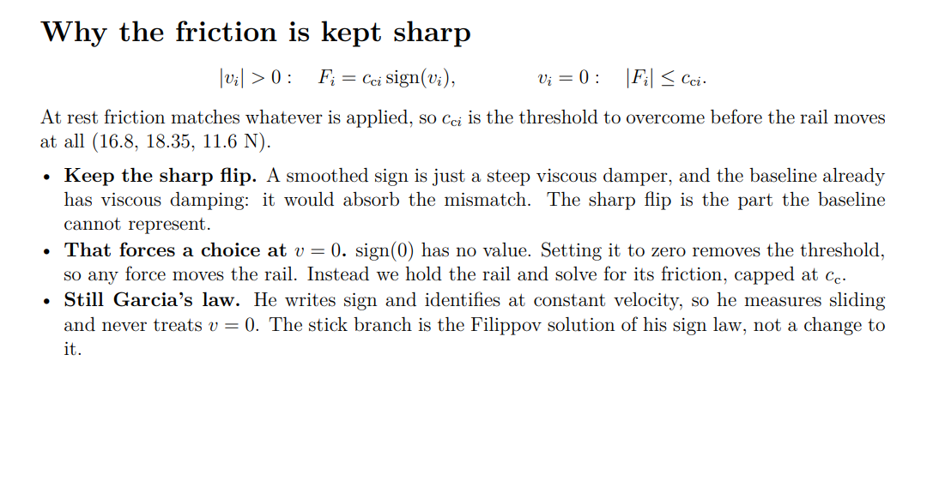
Notes:
That is literally the formula (v_eps = (cc/m)·ts is the velocity friction removes in one step) and it needs no notion of resolution. It is also the sentence you could defend if asked where the band comes from: it comes from the step size and the friction force, nothing else.
One fidelity note. The slide shows the base formula, but the code applies a safety factor: v_eps = 9 · (cc1 + cc2)/m · ts (V_EPS_MARGIN = 9). So if anyone computes it from the slide they will get a number 9x smaller than what runs. That factor is exactly the backup-slide material we discussed (the margin, the sweep, and Gate 3), so it is defensible to leave off the main panel, but you should know the slide's formula is the principle rather than the literal setting.

Slide 5
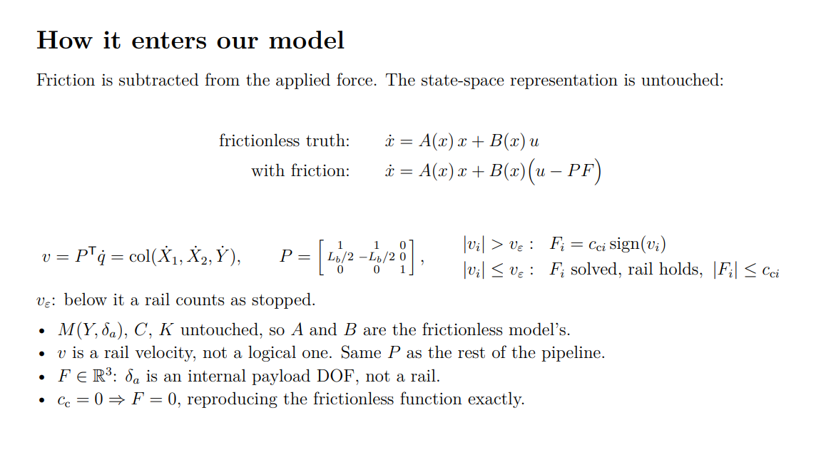
Notes:
▎ "The simulation runs in fixed time steps, and numerically a velocity is never exactly zero. So we need a threshold to decide when a rail counts as stopped. We set it to the speed friction can remove in one time step: friction decelerates the rail at cc over m, so that times the time step. Below that, the rail would be stopped before the next step anyway."
the simulation runs in steps, and a velocity is never exactly zero numerically, so we need a threshold to decide when a rail counts as stopped. We set it to the speed friction would remove in a single step.
▎ v_eps: below it a rail counts as stopped, since a velocity is never exactly zero numerically. Friction decelerates at cc/m, so one time step removes v_eps = (cc/m) t_s.
The code does not use (cc/m) t_s. It uses v_eps = 9 · (cc1 + cc2) / m_total · t_s
One global band for all three rails, with a safety factor of 9. So (cc/m) t_s on a slide is the principle, not the setting, and anyone who computes it gets a number 9x too small.

Slide 6
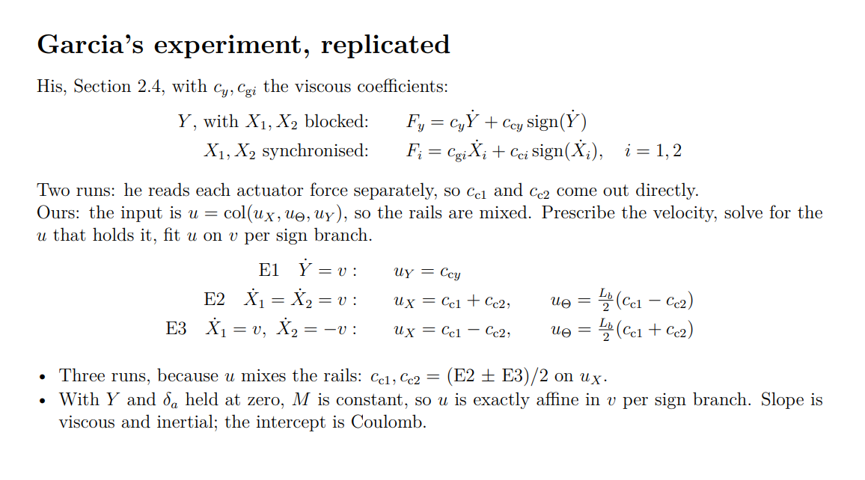
Notes:
Because we cannot measure the two X rails separately. Our model's input is the combined push on the cross-arm, not the two motor forces.
So it is like two boxes you can only weigh together:
push both rails the same way -> you measure cc1 + cc2
push them opposite ways -> you measure cc1 - cc2
sum and difference -> cc1 and cc2 separately
That is E2 and E3. Neither one alone can tell you the two values; together they can.
E1 is the Y axis, which is a separate motor with nothing to untangle, so one run gives ccy directly.
To avoid the cross-arm to rotate, axes X1 and X2 are blocked, i.e. X1 = X2 = constant. Then, the Coulomb and viscous frictions of the Y–axis are estimated by displacing the payload at various constant velocities.
▎ "The viscous and Coulomb frictions of actuators X1 and X2 are estimated by moving them in synchronization at various constant velocities, i.e. Ẋ1 = Ẋ2.“
M is not constant. From gantrySystemExtendedCoulomb.m:99-102 it depends on Y and on delta_a. A supervisor who has seen panel 3's M(Y, delta_a) will read "M constant" on panel 4 and immediately object.It is constant in this experiment, and only because of how the experiment is set up. Gate 1 pins Y = 0 and delta_a = 0 and varies only the velocities. So M is evaluated at a single configuration throughout the sweep.

Slide 7
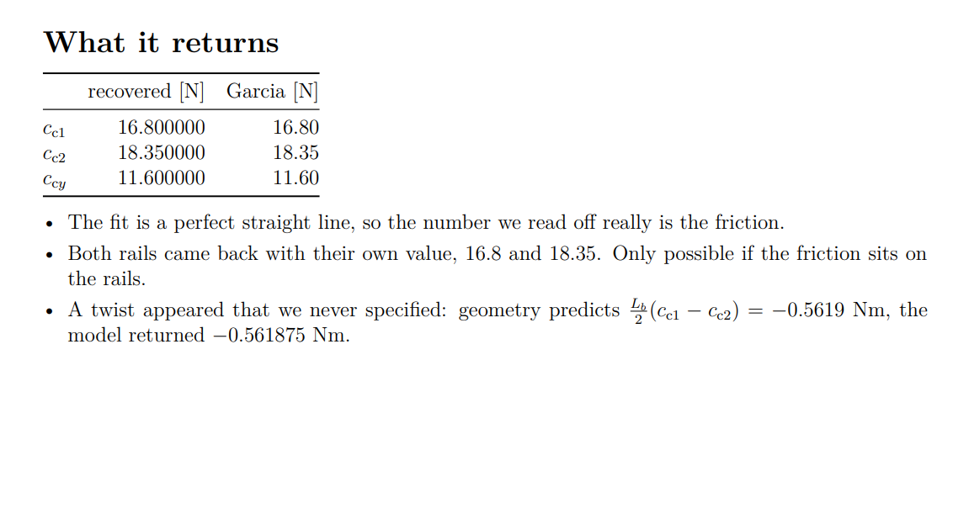
Notes:
Bullet 1 — the reading is clean.We get cc by fitting a line and reading where it crosses zero velocity. That only works if the data is genuinely a straight line. It was, to machine precision. So the number we read is really the friction and not a curve being misread.
Bullet 2 — the two rails came back different.We asked for 16.8 on one rail and 18.35 on the other, and got both back separately. That is only possible if the friction really lives on the individual rails. Had we coded it on the cross-arm's X and Theta instead, the two numbers could not come apart.
Bullet 3 — a twist appeared that we never asked for.We specified friction on three rails and nothing on rotation. But the two rails pull with different strength at opposite ends of the arm, so the arm gets twisted. That twist is -0.5619 Nm by geometry, and the model returned -0.561875 Nm. We never put it in; it fell out.

Slide 8
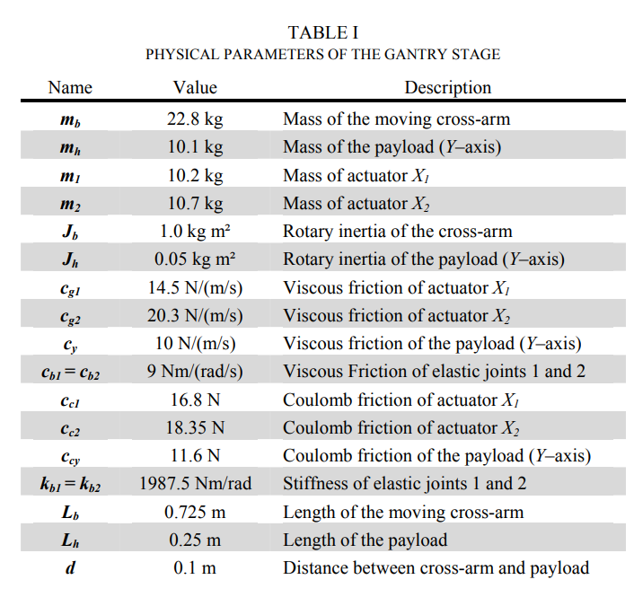
Notes:
Bullet 1 — the reading is clean.We get cc by fitting a line and reading where it crosses zero velocity. That only works if the data is genuinely a straight line. It was, to machine precision. So the number we read is really the friction and not a curve being misread.
Bullet 2 — the two rails came back different.We asked for 16.8 on one rail and 18.35 on the other, and got both back separately. That is only possible if the friction really lives on the individual rails. Had we coded it on the cross-arm's X and Theta instead, the two numbers could not come apart.
Bullet 3 — a twist appeared that we never asked for.We specified friction on three rails and nothing on rotation. But the two rails pull with different strength at opposite ends of the arm, so the arm gets twisted. That twist is -0.5619 Nm by geometry, and the model returned -0.561875 Nm. We never put it in; it fell out.

Slide 9
Notes:
Bullet 1 — the reading is clean.We get cc by fitting a line and reading where it crosses zero velocity. That only works if the data is genuinely a straight line. It was, to machine precision. So the number we read is really the friction and not a curve being misread.
Bullet 2 — the two rails came back different.We asked for 16.8 on one rail and 18.35 on the other, and got both back separately. That is only possible if the friction really lives on the individual rails. Had we coded it on the cross-arm's X and Theta instead, the two numbers could not come apart.
Bullet 3 — a twist appeared that we never asked for.We specified friction on three rails and nothing on rotation. But the two rails pull with different strength at opposite ends of the arm, so the arm gets twisted. That twist is -0.5619 Nm by geometry, and the model returned -0.561875 Nm. We never put it in; it fell out.

Slide 10
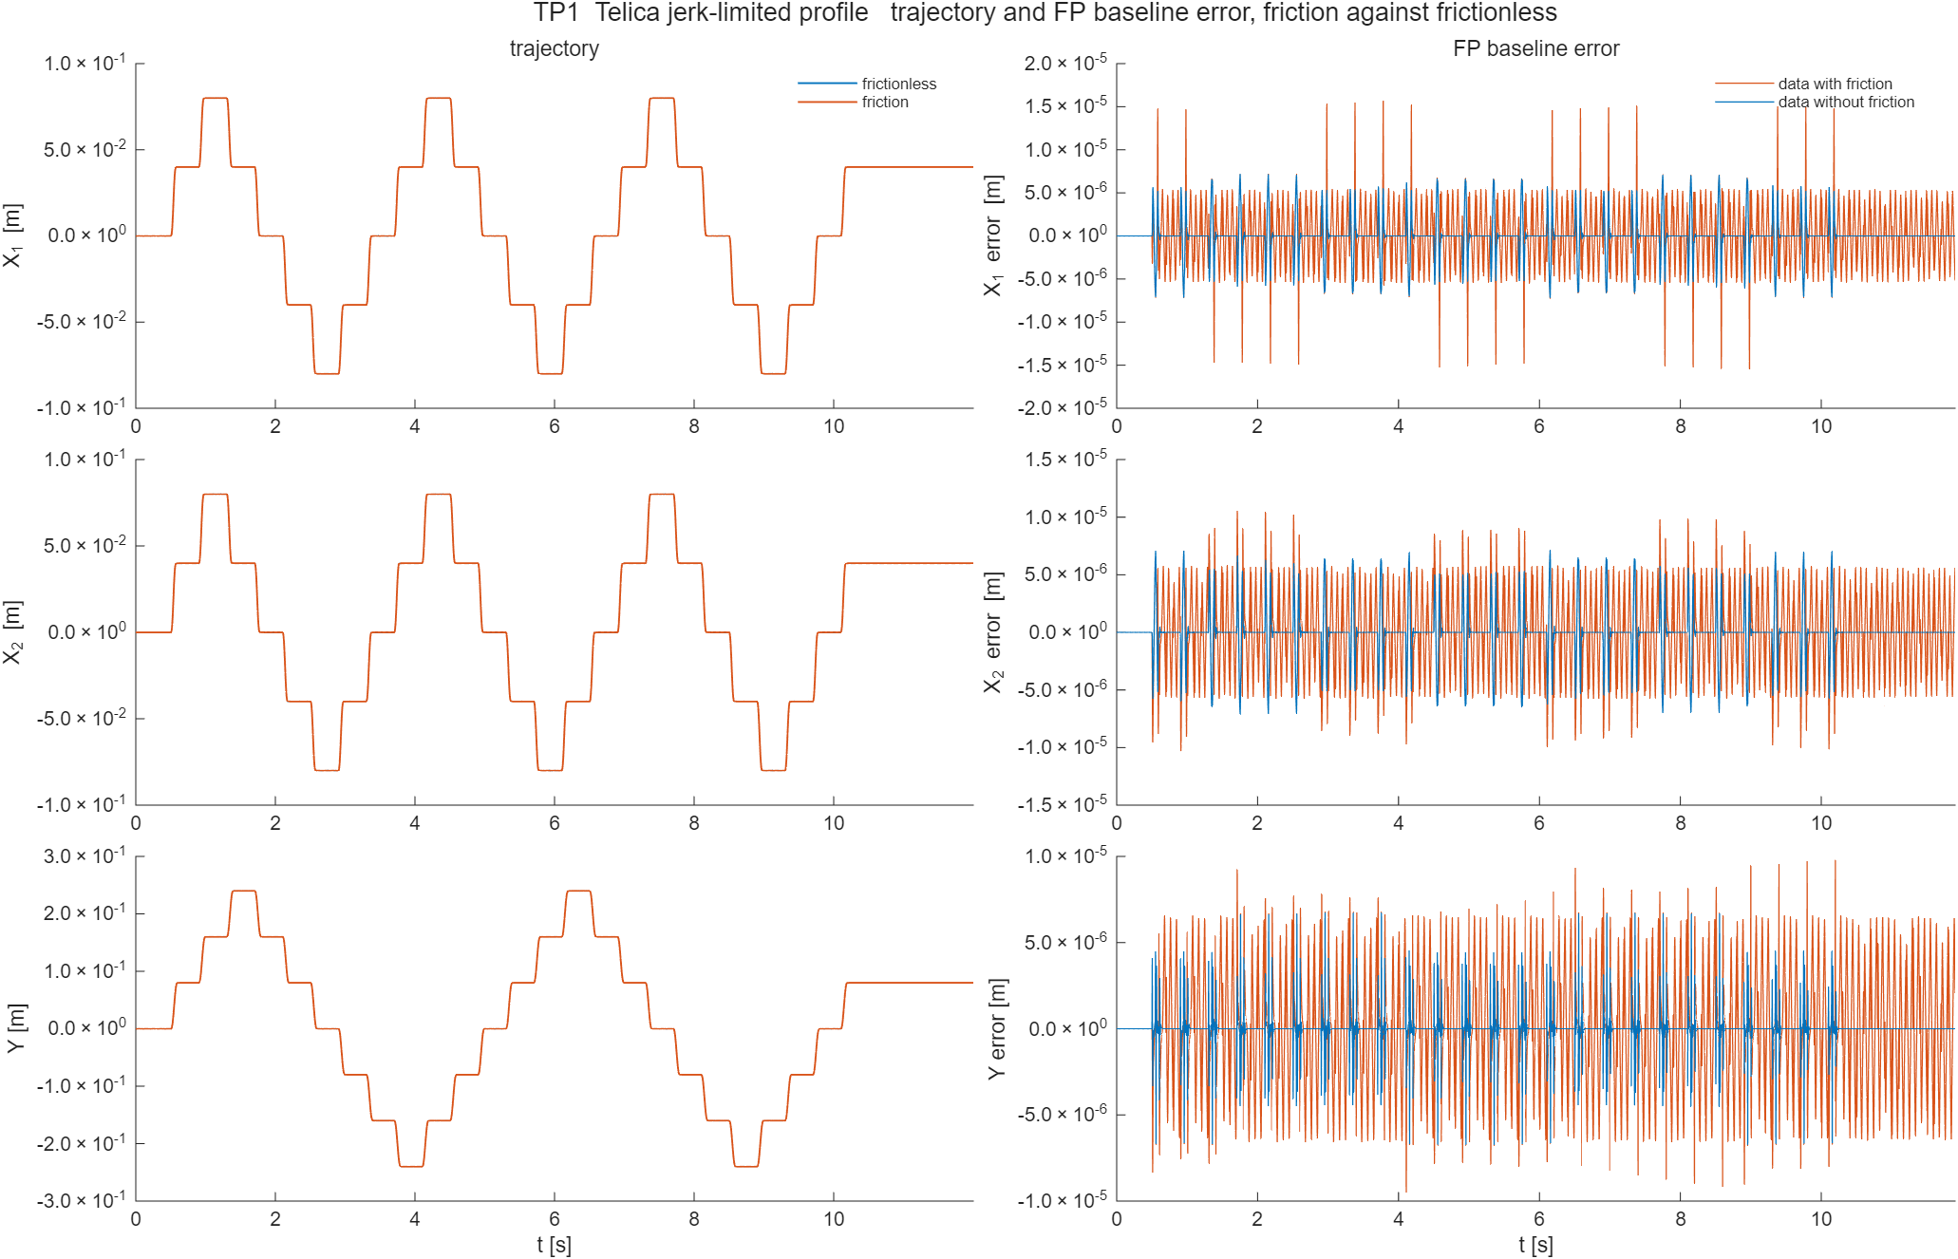

Slide 11
SNR ILC data
Kijken sensitvity mismatch meten op

